Slide 1
Banana Shelf-Life Prediction
Ashwini Pisal

Slide 2
About & Purpose
Banana shelf-life prediction as name suggests, we are trying to find which day banana it is and number of days given banana will last.
We usually buy food items from shop just by looking at it, we can not determine how many days will it be eatable.
By identifying shelf-life for a given banana we can avoid food wastage and can have it on right time

Slide 3
Approach
There are two parts
Dataset creation
Different stages of banana captured on daily basis
Feature set creation
My feature set includes
Color based pixel count
Area percentage of spots in an image
Count the spots in an image

Slide 4
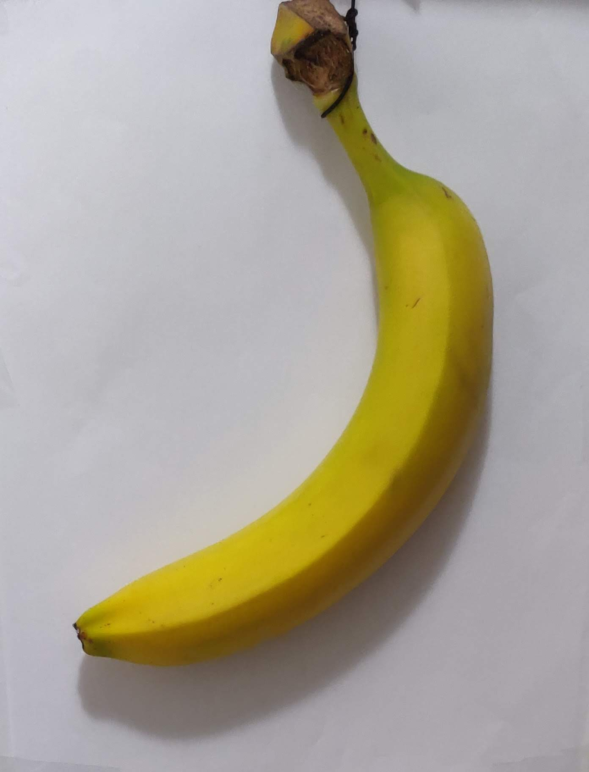
Settings & Dataset Creation
First camera is calibrated.
Light adjustment in room, to avoid shadows.
Identified the location in room from where light will be reflected properly.
A-4 white paper sheets placed on table and above that banana is place.
Images where captured in top view for horizontally placed banana
Currently we are taking front and back of Banana.
Banana images are captured on daily basis, till it is completely spoiled.

Slide 5
Feature Extraction Process
For a given image, its background will be removed
To remove a background, I am using Color thresholder app in MATLAB. I am using background removal using HSV and LAB Color space.
Once background removed from image, apart from object remaining part becomes gray for HSV based background removal.
RGB part of this image is actual object, for that Color pixel counts such as Yellow,Brown and Black pixel count calculated
Using the same RGB Part, area percentage of spots in image is calculated
After that RGB part of LAB background removal is used to calculate the spot count
These extracted features array saved in mat file for reference

Slide 6
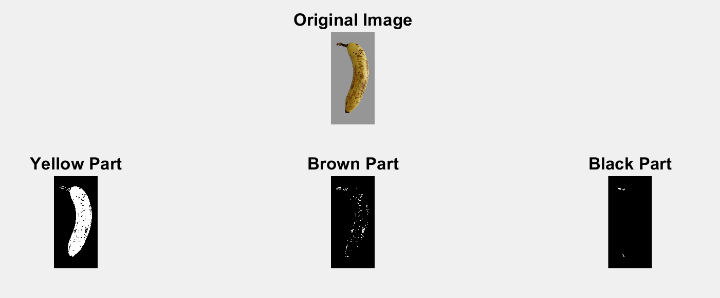
Color-By Hue
Calculated HSV values for an image
Set the Sthreshold and Vthresold between 0.1 to 1
Convert Hue to angles
Set the Hue ranges,Sthreshold and Vthreshold as per the different colors
Get the number of pixels in that Color range

Slide 7
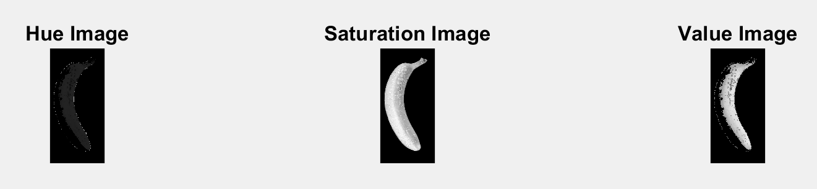
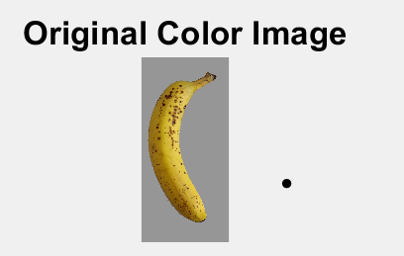
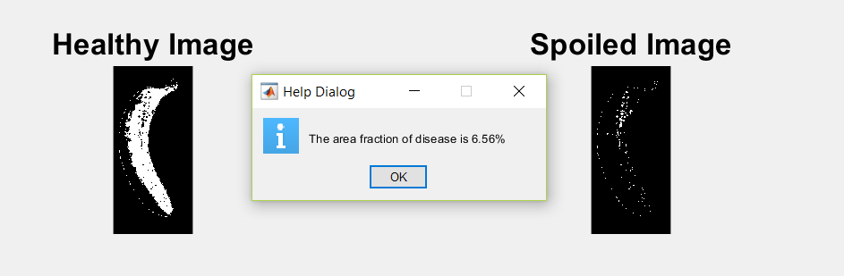
Spoiled Area calculation
Clear boundary regions of image
Get HSV values for image
Range the v- value to get pixels(v < 0.6)
Xor pixels to get background region
Range the H- value to detect healthy part of fruit(h > 0.105) & (h < 0.9)
By taking complement of that part and background part we get spoiled part
Take sum of complement of background pixels to get area of interest
Sum the spoiled part pixels and divided by area of interest pixels to get percentage

Slide 8
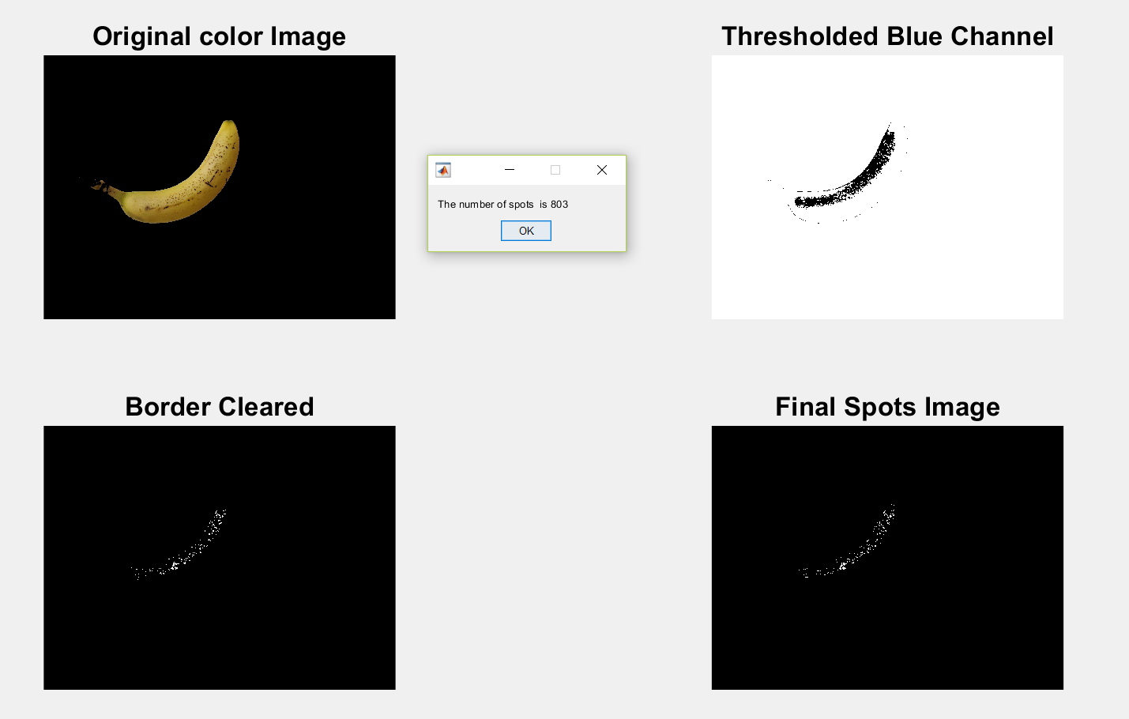
Count Spots
Get the RGB channel values from image.
Threshold the b-channel. blueChannel < 75.5
Clear the spots boundary.
Count the spots.

Slide 9
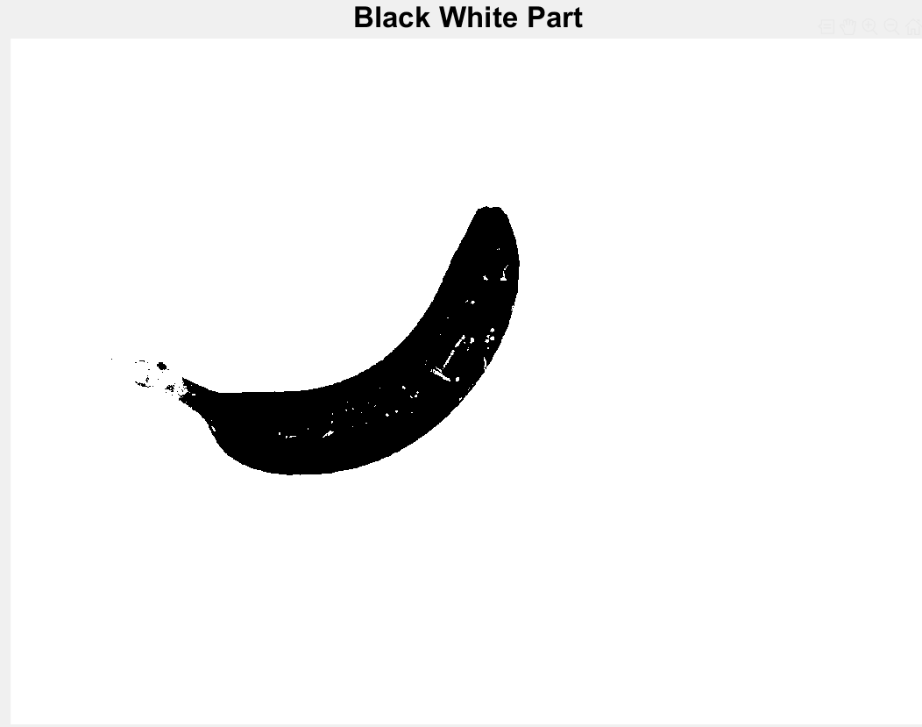
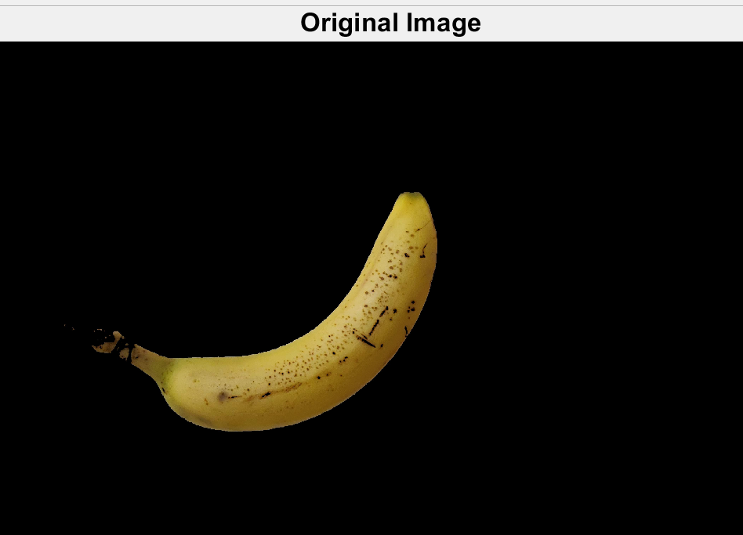
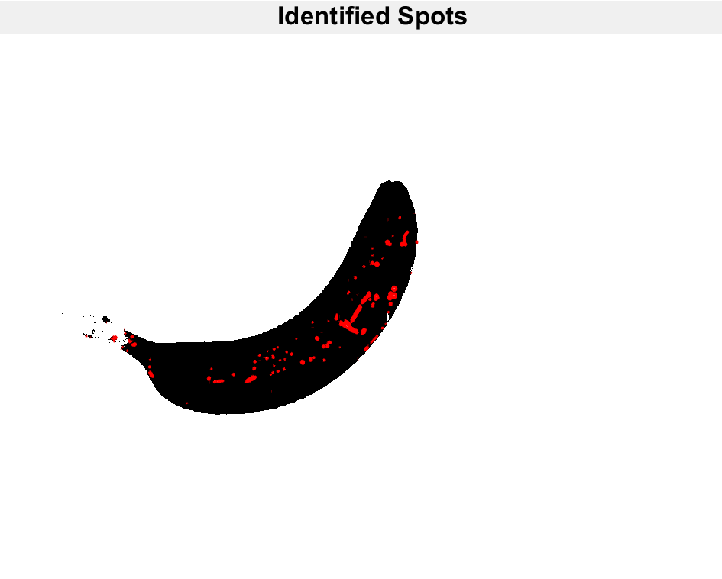
Count Spots
Convert image to grayscale.
Threshold the gray image.
Assigns black Color to all the pixels that have luminosity than a threshold level and the others as white.
we complement the image.
Find the boundaries of the object.

Slide 10
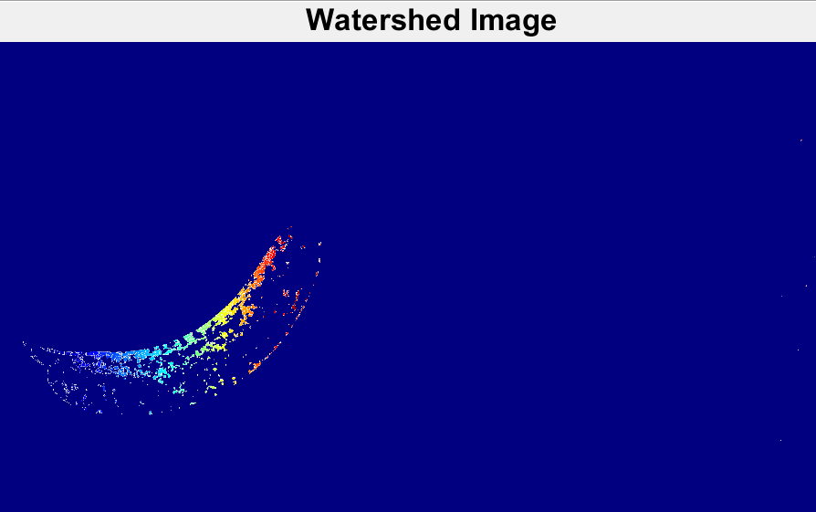
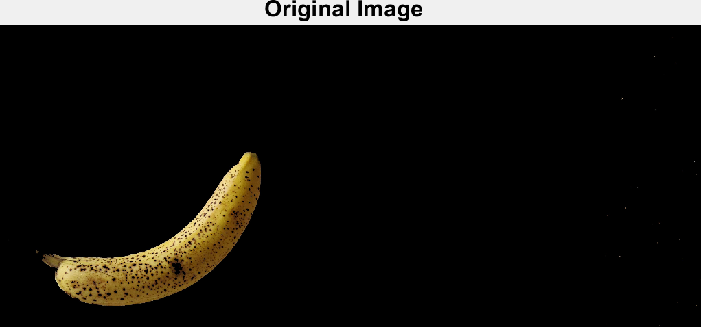
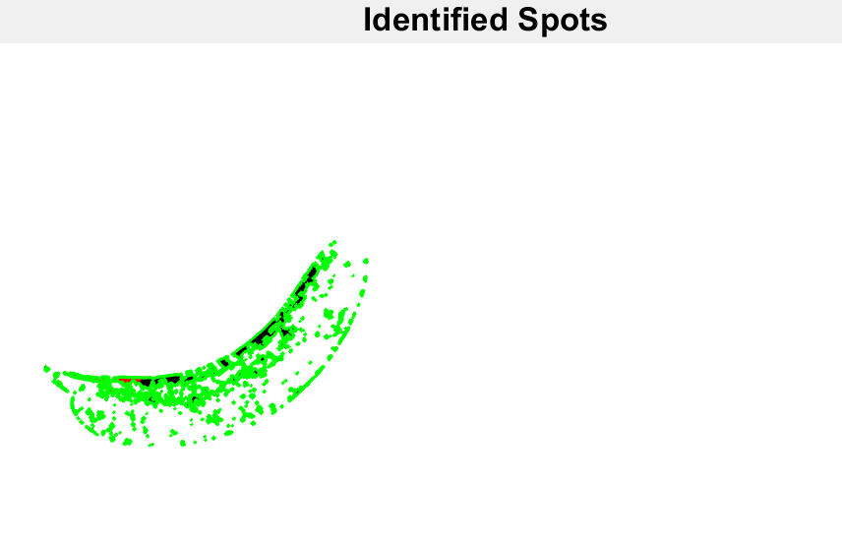
Watershed To Segment Spots
Convert image to gray.
Apply tophat transform to smooth out the uneven illumination.
Determine good threshold and Convert it to binary.
we compute the distance transform of the complemented binary image
compute the watershed transform.
display the segmented objects using different colors
Find the boundaries of the object.

Slide 11
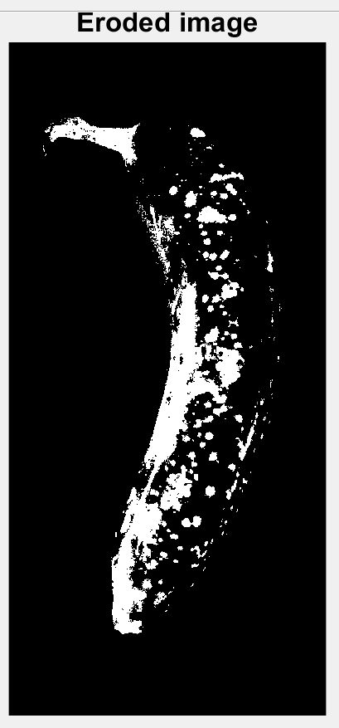
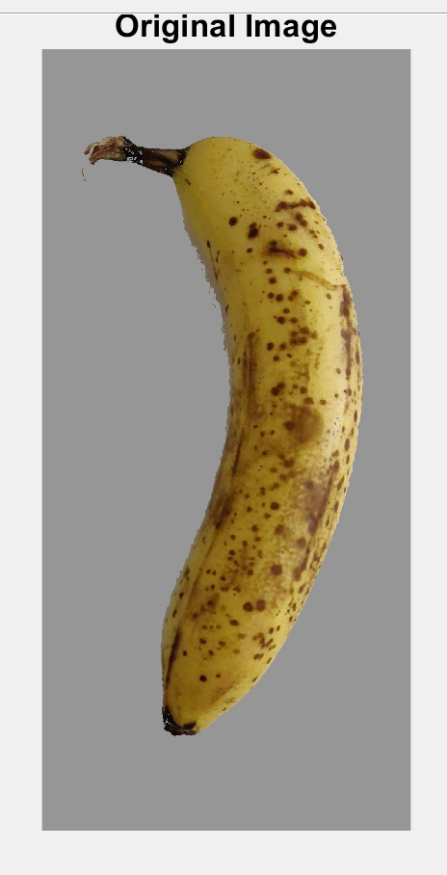
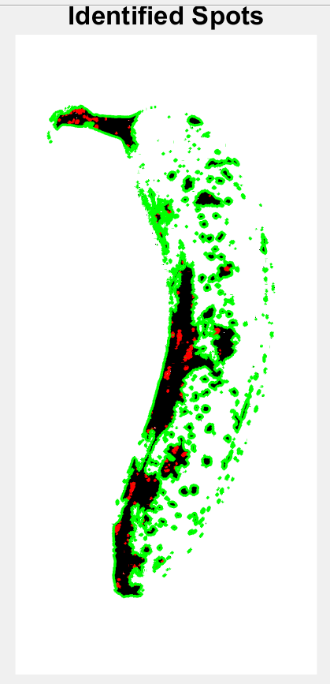
Erosion To Detect Spots
Convert image to binary.
Select structuring element for an image.
Apply erosion to an image.
Find the boundaries of the object.

Slide 12
Testing
Once feature set is ready, test images can be tested. Here we are testing one image at a time.
Feature set images count: 100
Test set images count:50
Model will extract the same features for test input image. Features from created feature set compared with test image features and feature where difference is minimum it will be considered as match.
Matched feature provides a day when that image sample was captured and in how many days that banana was spoiled.
Shelf-life will be identified as difference between number of days banana fully ripened and the day when image was taken.

Slide 13
Validation
To validate the model, I am considering two metrics
Number of correctly predicted images. (55%)
Mean absolute deviation (deviation is 1.05 to 1.25)
For each image is entered into the model. Shelf-life value is calculated. Then, the difference between the predicted value and the actual value is calculated. The absolute value of the difference is taken. Finally, the mean of all the calculated absolute deviations of each image is found.
Smaller MAD value better then prediction is better.

Slide 14
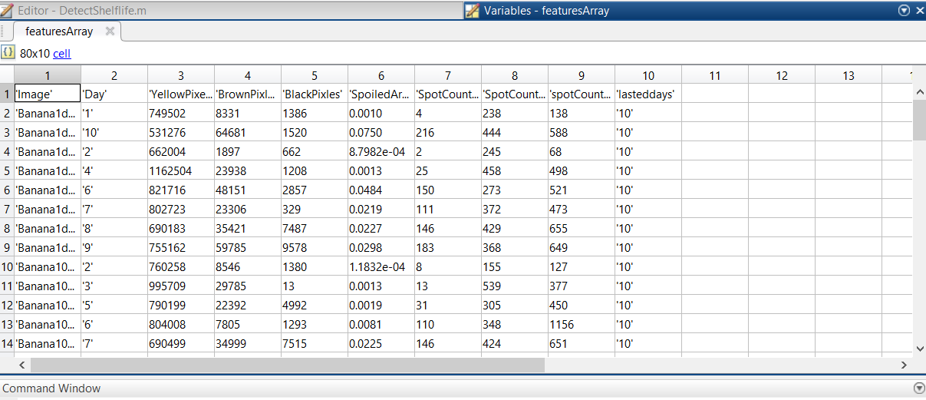
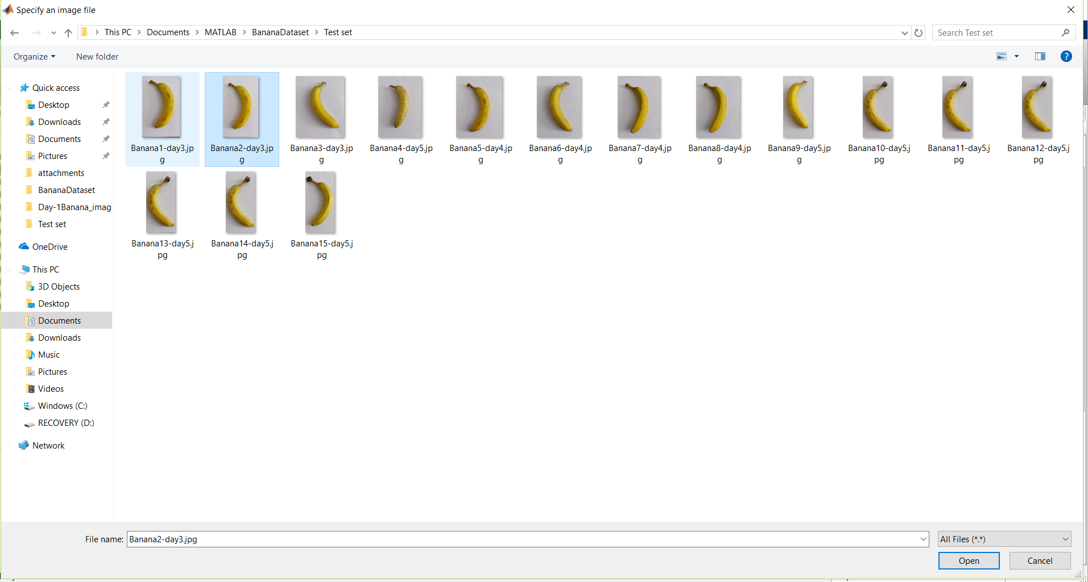
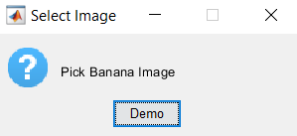
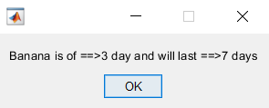
Results
Features Array of Train Images
Select Image
Select Test Image
Predicted shelf life

Slide 15
Limitations
Initially I had taken images by hanging fruit, in that scenario thread was used to hang object, shadow and lightening in room used to affect image background removal from image.
Dataset Creation: Banana with black tops used to effect the measurement of black pixel count. So selecting bananas which are similar was difficult. Some bananas will have green some of them might not have green Color. Getting right set of banana was difficult
Identifying spots region and counting spots has errors, it works properly if Banana has larger and prominent spots, for small and initial stage spots it is not able to identify all the spots correctly.

